Slide 1

Nuclear for Country Prosperity
UNPAM Tangsel, February 2023

Slide 2
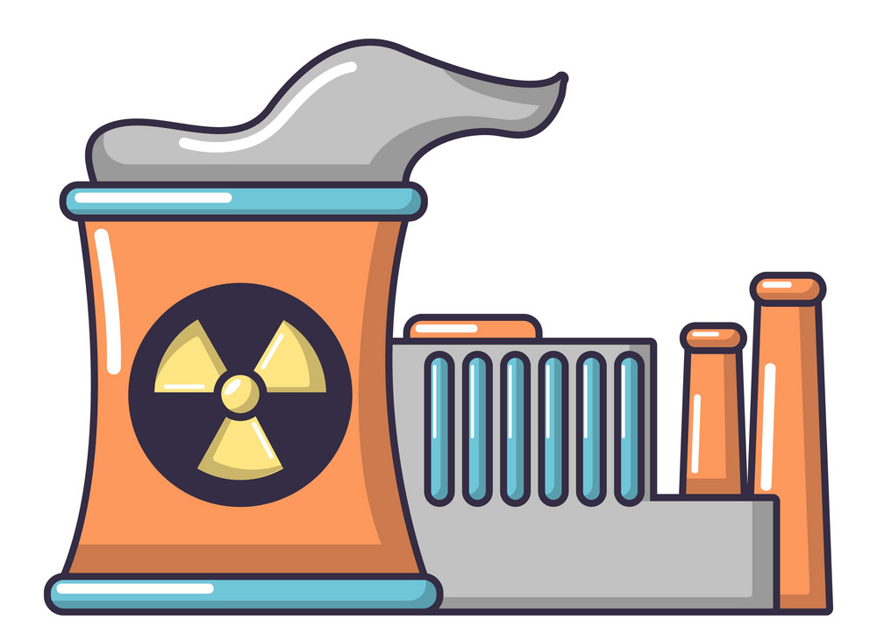


Status of NPPs in the Globe
449 Operation
52 In-progress construction
398.887 MWe On-power capacity
USA
96 reactor
97565 MWe
2 reactor
France
58 reactor
63130 MWe
1 reactor
China
48 reactor
44518 MWe
9 reactor
Japan
37 reactor
35947 MWe
2 reactor
Russia
36 reactor
28355 MWe
6 reactor

Slide 4
WHY NPP ?
EFFICIENT
RELIABLE
CLEAN

Slide 5
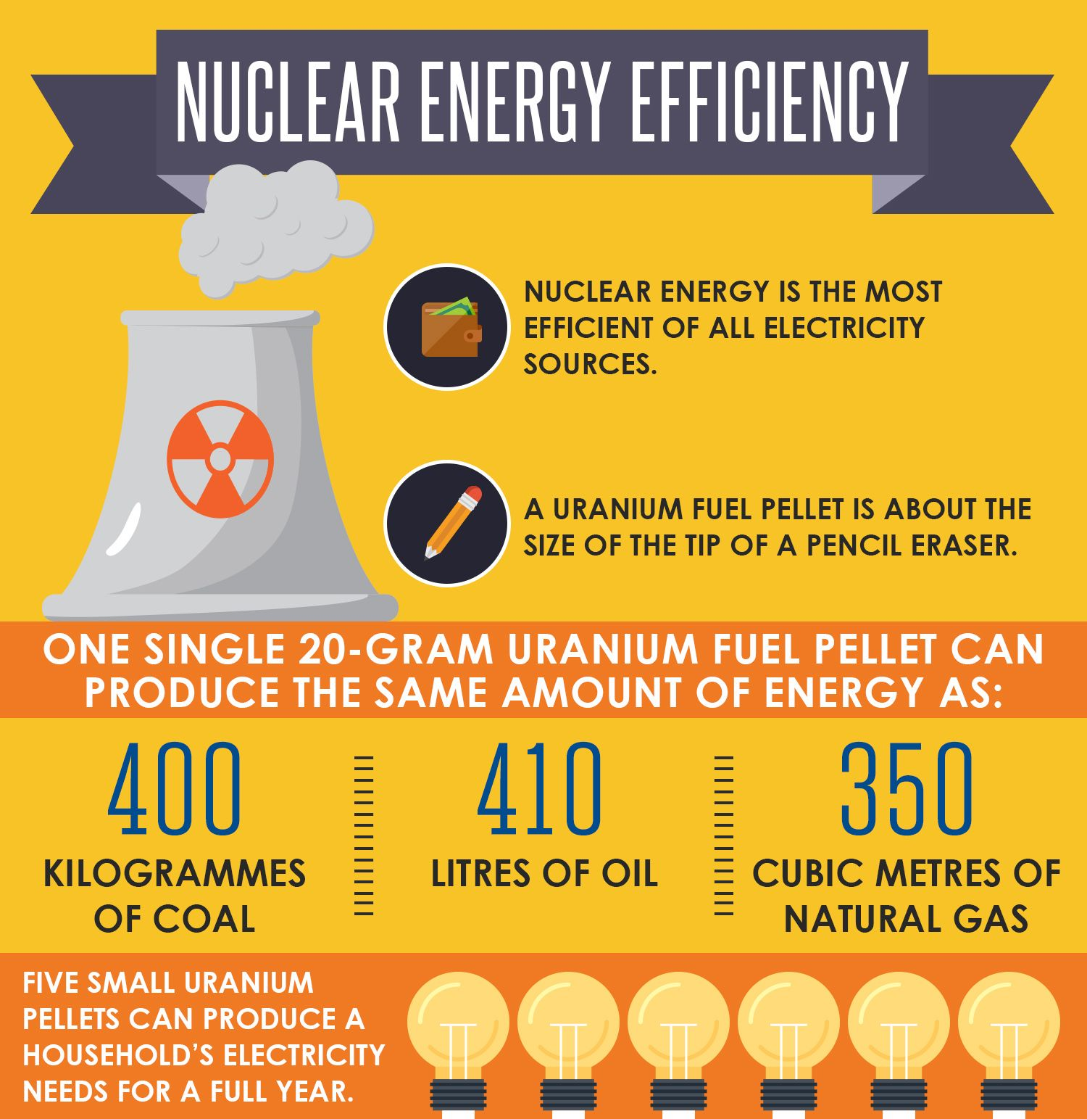
Fuel Comparative

Slide 6
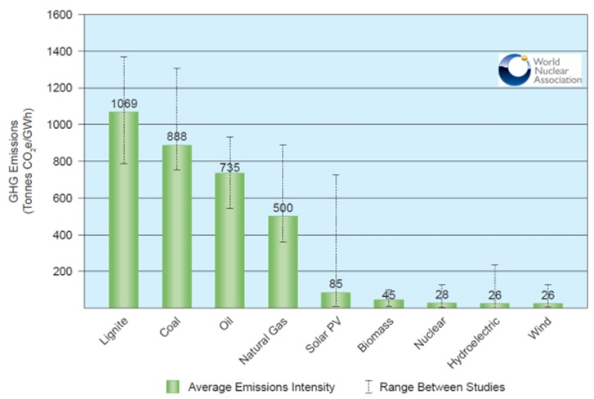
Carbon Emission Comparative

Slide 7
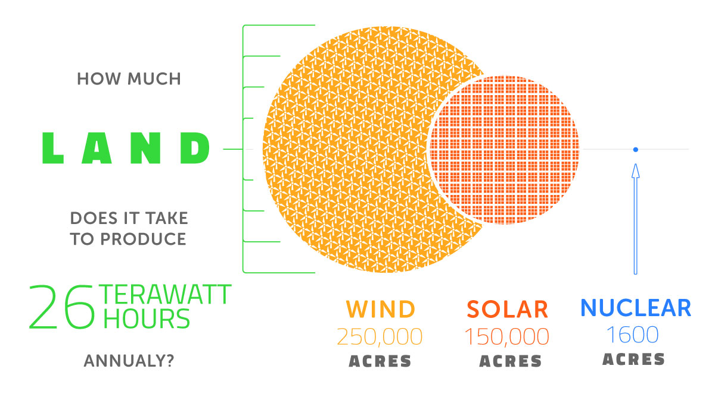
Land Need for Site

Slide 8
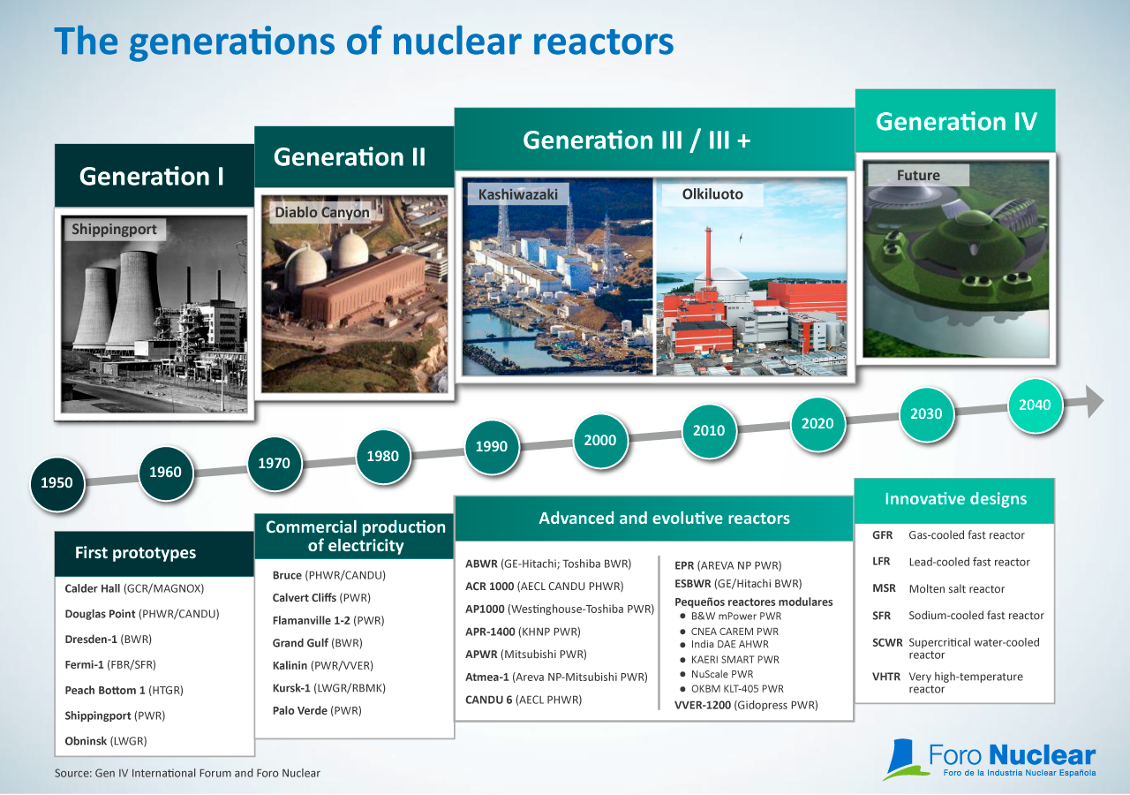
NPP Technology Development

Slide 9
Public Acceptance in Indonesia
59.70%
49.50%
52.90%
60.40%
72.00%
75.30%
77.53%
2010
2011
2012
2013
2014
2015
2016
Sustainable Energy
Renewable Energy
Friendly Environment
Technology Guarantee
Risk and Safety
High Cost Investment
Geopolitics Resistance
Public Acceptance

Slide 10
THANK YOU ANY QUESTION?

